Slide 1
Promotion and Tenure
Purdue
Faculty
October 16, 2012
Beverly Davenport Sypher
Vice Provost for Faculty Affairs

Slide 2
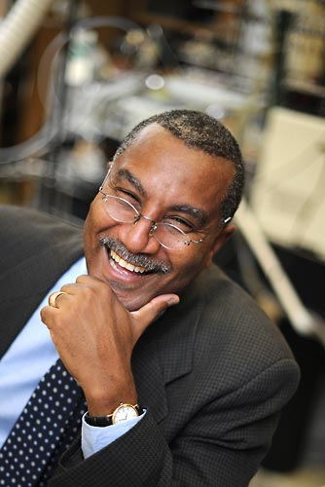
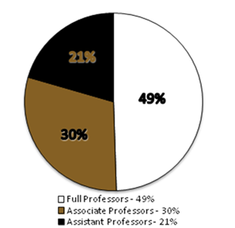
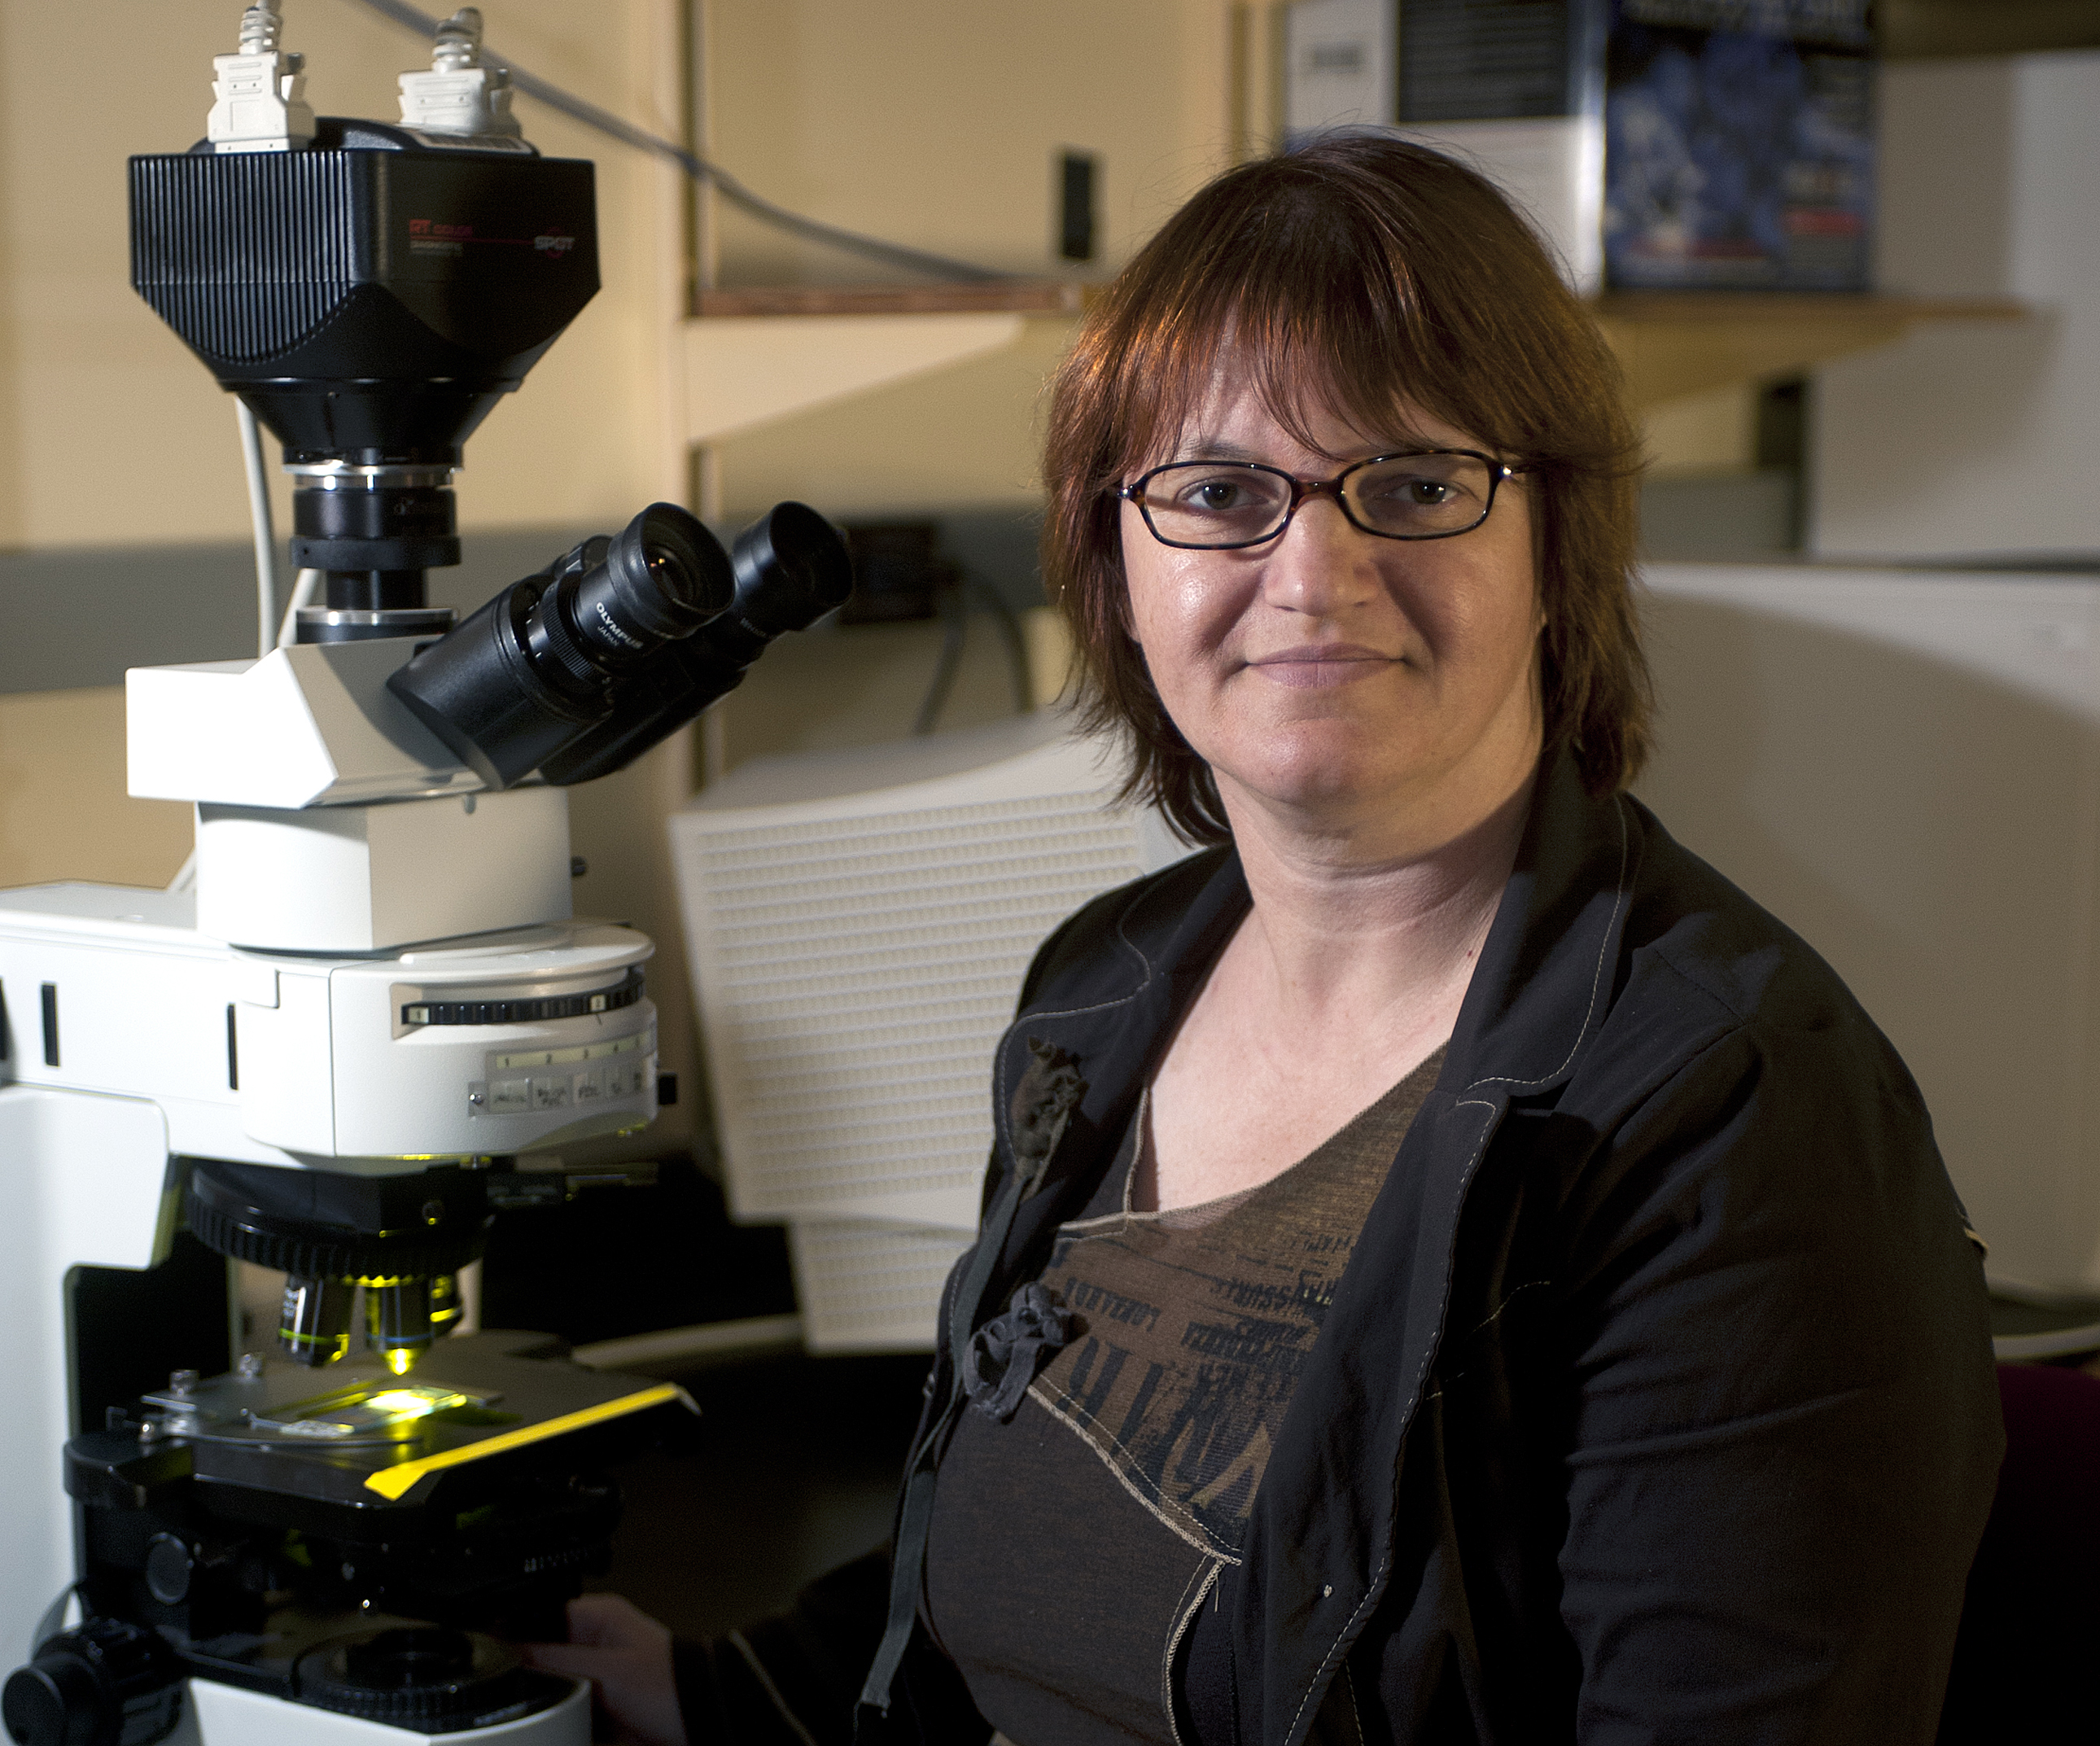
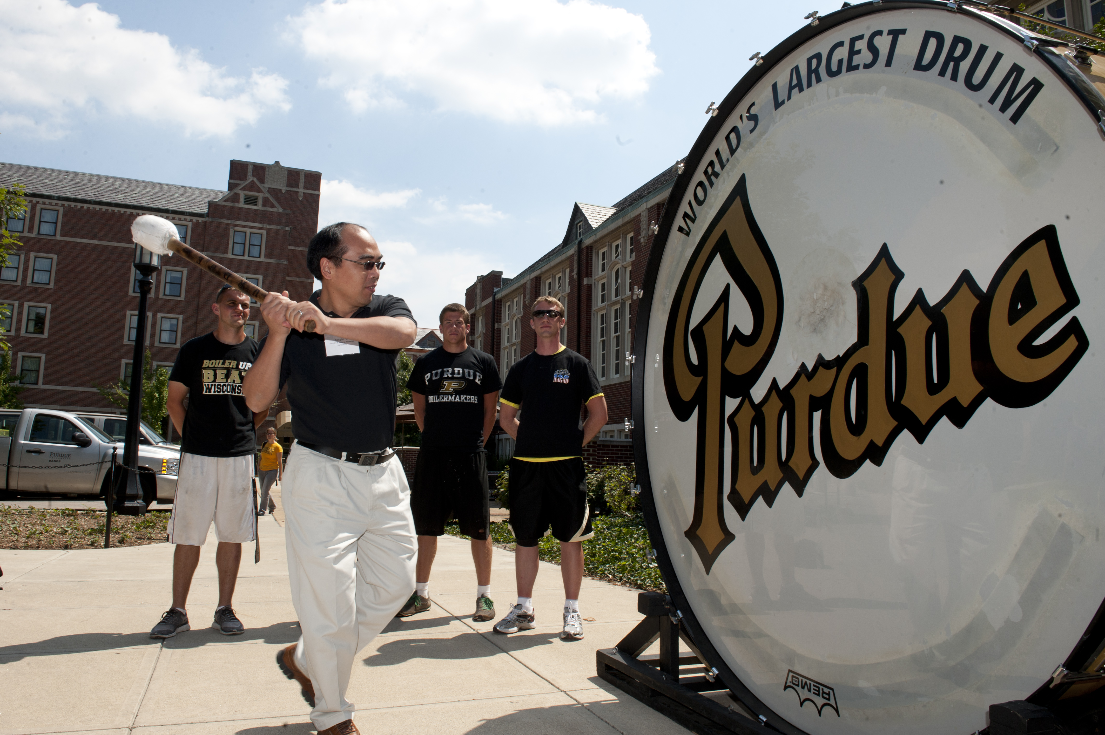
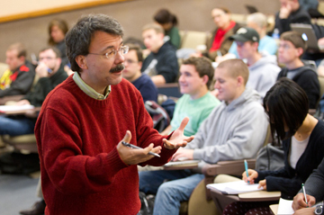
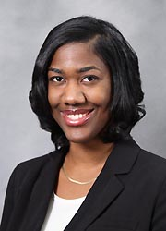
Purdue Faculty
2011-12
Notes:
Big 10 Faculty
among the best in the world.
nation’s most “formidable intellectual capital”
With Big 10 peers produce 1/3 of nation’s Ph.D.s and garner more research $$ than Ivies or West Coast taken together
Purdue Faculty:
Over 2000 faculty members generate more than 70% of the
student credit hours and over half a billion dollars in research
expenditures
they come from all over the world; more than 2/3 are American born
most educated in the U.S. usually at the most prestigious universities.
nearly three fourths are male.
27% women and 7% URM.

Slide 3
Purdue Faculty
2011-12
Notes:
Big 10 Faculty
among the best in the world.
nation’s most “formidable intellectual capital”
With Big 10 peers produce 1/3 of nation’s Ph.D.s and garner more research $$ than Ivies or West Coast taken together
Purdue Faculty:
Over 2000 faculty members generate more than 70% of the
student credit hours and over half a billion dollars in research
expenditures
they come from all over the world; more than 2/3 are American born
most educated in the U.S. usually at the most prestigious universities.
nearly three fourths are male.
27% women and 7% URM.

Slide 4
Promotion and Tenure
One of the strongest predictors of pre-tenure faculty satisfaction and success is understanding the promotion and tenure process.
At Purdue, the process is described in Executive Memorandum B-48, Section II and in Provost’s Letter
http://www.purdue.edu/provost/faculty/promotion.html

Slide 5
Tenure at Purdue
“…to be considered for promotion, a faculty member should have demonstrated excellence and scholarly productivity in at least one of these areas. Ordinarily, strength should be manifest in more than one of these areas.”
Learning (teaching)
Engagement (dept., profession, university, community, state, world)
Discovery (research)

Slide 6
Basis for Promotions
One basis | Discovery | Engagement | Learning
Professor | 29 | 1 | 2
Associate Professor | 41 | 1 | 7
Two or more bases | Discovery and Engagement | Discovery and Learning | Learning and Engagement
Professor | 4 | 9 | 0
Associate Professor | 4 | 6 | 6

Slide 7
Tenure at Purdue
To receive tenure, “a successful candidate should have a significant record of accomplishment as a faculty member and show promise of continued professional growth and recognition.”
Candidates are considered on “standards appropriate for the nominee’s discipline and the University’s criteria for promotion.”

Slide 8
Time to Tenure
Assistant Professors typically have a probationary
period up to 6 years to earn promotion and tenure.
The 6th year is called the “penultimate year.” It is the
last year in which one is eligible for tenure.
Entering associate professors have 3 years to work
toward tenure. The 3rd year is penultimate year.

Slide 9
Tenure Clock Extensions: When conditions and personal circumstances substantially interfere with progress toward achieving tenure
A one-year automatic approval will be granted for birth of a child and adoption, provided a Request for Tenure-Clock Extension form is submitted within one year of the occurrence and prior to the penultimate year. This provision applies to either or both parents.
Justifiable conditions for granting exclusions include, but are not necessarily restricted to, severe illness, disability, or care-giving of a family member.

Slide 10
Levels of Review
Primary Committee: all full professors and
tenured associate professors (Oct. and Nov.)
Area Committee: Dean, heads, some or all full
professors (Dec.)
University Committee: Provost, Deans, and 7
faculty (February)
President and Board of Trustees approval
(April)

Slide 11
Keys to faculty success and well-being
Getting oriented to the institution
Learning what is expected early on
Learning the tenure and promotion process
Begin with the end in mind
Excelling at teaching and research; engagement and service increase over one’s career
Developing professional networks/mentors inside and outside the department
Seeking advice from mentors
Soliciting feedback from senior faculty and head
Creating work-life balance
Notes:
You have 5 years (without any tenure clock extensions) to showcase your excellence
Quality and impact (not necessarily quantity) are key

Slide 12
Rethinking Faculty Work:
Higher Education’s Strategic Imperative
“The faculty in American colleges and universities have always been the heart of the institutions where they work, the intellectual capital that ensures those institutions’ excellence. The quality of the faculty relates directly to the effectiveness of a college or university in facilitating students’ learning, creating new knowledge and linking research and practice in ways that benefit society.” (Gappa, Austin & Trice (2007, xi)
Purdue faculty are our brand—what faculty make moves the world forward!
Notes:
Duderstadt (2011), the world’s “most formidable intellectual capital” is going to have to “out-innovate, out-educate and out-think” our competitors to be successful.
Purdue is also going to have to out-recruit a larger and more diverse faculty, especially in certain areas, retain the gains we make and redouble our efforts to create and maintain an environment where faculty and their families want to live and work.

